Slide 1

Competitive Programming From Problem 2 Solution in O(1)
P
T
H
I
N
K
F
A
S
T
S
Algorithms: What and Why
Mostafa Saad Ibrahim
PhD Student @ Simon Fraser University

Slide 2
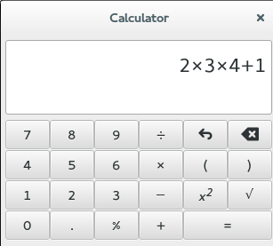
How to implement?
A normal calculator program. Direct translation for requirements can do it!
Remember to respect math: 2+1*5 = 7 NOT 15

Slide 3
How to implement?
Given 1000 integers, find how many 3 numbers with sum 400?
We can do 3 loops and try every 3 numbers!
Hmm..1000000000 operations! Too much Computations!
Given 1000 integers, sort them?
Hmm...nothing direct in mind...I need to think more!
Given airport locations and cost of every direct flight, find flight from cairo to new york with the minimum cost?
Hmm...how to represent airports relations!

Slide 4
How to implement?
Facebook site has 1.4 Billion users, please suggest to mostafa all new friends from them, where there is exactly 2 friends between mostafa and each of a new friend?
For every user in the system
Count intersection of mostafa users and this user
If count == 2, we suggest this friend
Hmm...too many billion operations
Hmm...system memory can’t hold even all of that!
Our solution performance is too bad!

Slide 5
Performance
In real life applications, we care with many factors
E.g. Usability, Security, Maintainability, Reliability...etc
One of the major factors is the performance
A memory and time efficient applications are desirable features.
Imagine if facebook is a slow application!
This is where algorithms field arises!
Computational solution that is efficient time and memory

Slide 6

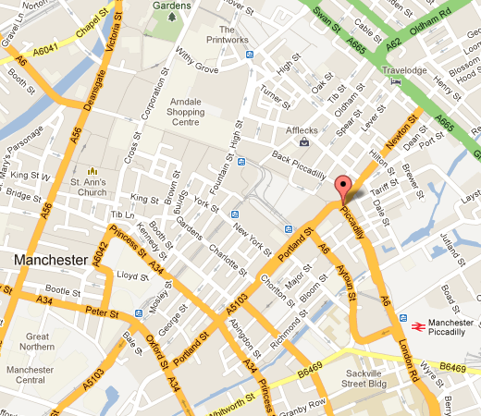





High performance real life apps

Slide 7
Algorithms - خوارزميات
Algorithm: A sequence of steps to solve a Computational problem.
Decision - Search - Counting, Optimization ... problems
Nature of Computational problem
Much of computations
Direct requirements translation is not doable..must think
Or doable, but direct idea is so slow..or takes much memory….we need a more efficient solution
History: محمد بن موسى الخوارزمی‎

Slide 8
Algorithms Fields
Sort & Search algorithms
Graph algorithms (E.g. shortest path problem)
Dynamic Programming & Greedy algorithms
String algorithms (E.g. in search engines)
Game theory, Numerical algorithms
Number-theoretic algorithms
Combinatorial algorithms
Computational geometric algorithms
We can’t solve efficiently every problem

Slide 9
Algorithms Analysis
Given an algorithm, we need to
1) Prove its Correctness
2) Measure time efficiency
3) Measure memory efficiency
Steps 2 and 3 allow us to compare algorithms
Fall in complementary area: Computational Complexity
An example of sorting algorithms
Selection sort, orders N numbers using N*N operations
Quicksort, orders N numbers using N*log₂N operations
Then Quicksort is faster...and better algorithm

Slide 10
Sorting Problem
Given N numbers, sort them (small first)?
What about following approach?
Get the minimum element in the array
Swap it with first element in array
Now, in the remaining numbers, do same, swap with 2d
Again, in the remaining numbers, do same, swap with 3rd
This way, 1st element is smallest..2nd element is 2nd smallest...etc...so whole array is sorted
Let’s simulate a sample :)

Slide 11
Sorting Problem: Simulation
5 4 9 7 1 2
Smallest in the array is 1, Swap it with 1st element
1 4 9 7 5 2
Smallest in the remaining is 2, Swap it with 2nd element
1 2 9 7 5 4
Smallest in the remaining is 4, Swap it with 3rd element
1 2 4 7 5 9
1 2 4 5 7 9
1 2 4 5 7 9
1 2 4 5 7 9

Slide 12
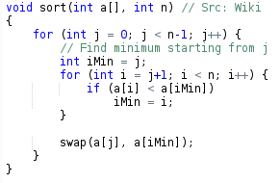
Sorting Problem: Code

Slide 13
Sorting Problem: Analysis
Let’s analyze our performance
Memory
We need N integers for the array + some constants
So we are using linear memory relative to N
Time
Given N numbers, we do around N * (N-1)/2 iterations
Each iteration has some comparison and assignments
So we are using quadratic (N²) operations relative to N
This algorithm is called Selection Sort
Quick Sort algorithm needs NlogN operations

Slide 14
Data Structures
Data Structure is a structure of data elements associated with efficient operations of interest over these data elements.
Example: We need to maintain some integers such that we can push them inside our data structure, but when request to get element, we get the last element...or the smallest element.
Basically, we may think in internal array with an operation to get this last/smallest/largest/median...element
Last element is stack structure...smallest is heap

Slide 15
Data Structures
There are basic structures...and advanced ones
Things can be more complex
E.g. a way to represent the airports relations and find trips
E.g. we need to represent the streets and find paths
E.g. given ranges (a, b), get how many ranges include c?
Usually studied after programming and before or with algorithms
See my data structures playlist

Slide 16
Algorithms Materials
Introduction to Algorithms (CLR).
Algorithms in C++ (or Java)
The Algorithm Design Manual
The Art of Computer Programming
Videos
My crash course series
Other Arabic series can be found here
Many on web for MIT, Stanford and others

Slide 17
Programming Prerequisites
For the majority of algorithms you need basic programming concepts
Data types and variables
Selection, Repetition, Functions, Arrays, Struct (class)
See my programming playlist
Yes just basics, but you need to be clever
For little algorithms, a data structure course is needed

Slide 18
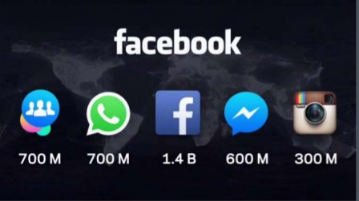
Algorithmic Interviews
Top companies run applications that has millions of users
They perform many algorithmic & data structures interviews to assess newcomers!
See my video
about interview

Slide 19
تم بحمد الله
علمكم الله ما ينفعكم
ونفعكم بما تعلمتم
وزادكم علماً

